Slide 1

Book Recommendation
Team# 1
Mentor: Neha Gupta
05/11/2022

Slide 2
Business Objective:
To Generate the features from the dataset and use them to recommend the books accordingly to the users.
Content:
The Book-Crossing dataset comprises 3 files.
Users : Contains the users. Note that user IDs (User-ID) have been anonymized and map to integers. Demographic data is provided (Location, Age) if available. Otherwise, these fields contain NULL-values.
Books Books are identified by their respective ISBN. Invalid ISBNs have already been removed from the dataset. Moreover,
some content-based information is given (Book-Title, Book-Author, Year-Of-Publication, Publisher), obtained from Amazon Web Services. Note that in case of several authors, only the first is provided. URLs linking to cover images are also given, appearing in three different flavors (Image-URL-S, Image-URL-M, Image-URL-L), i.e., small, medium, large. These URLs point to the Amazon web site.
Ratings Contains the book rating information. Ratings (Book-Rating) are either explicit, expressed on a scale from 1-10 (higher values denoting higher appreciation), or implicit, expressed by 0.

Slide 3

Project Flow:
Understanding the dataset
Deployment and recommendation
Evaluation
Cleaning
Combining the models to address cold start
issue
EDA
Popularity based
Merging the datasets
Model building
Collaborative

Slide 4
USERS

Slide 5
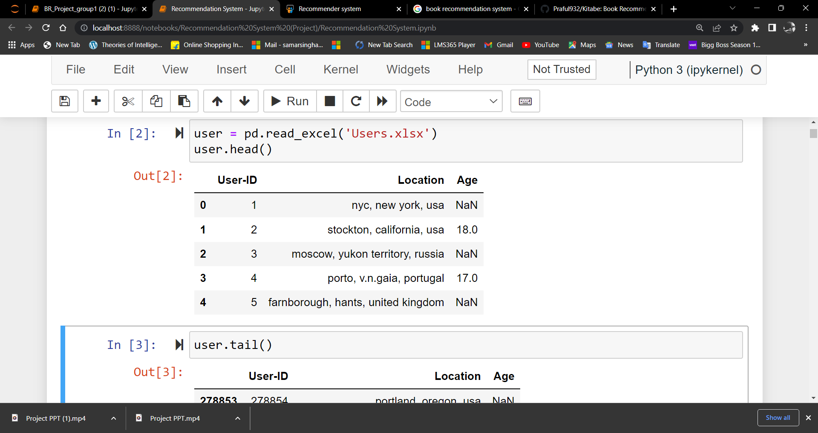
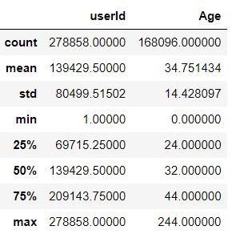
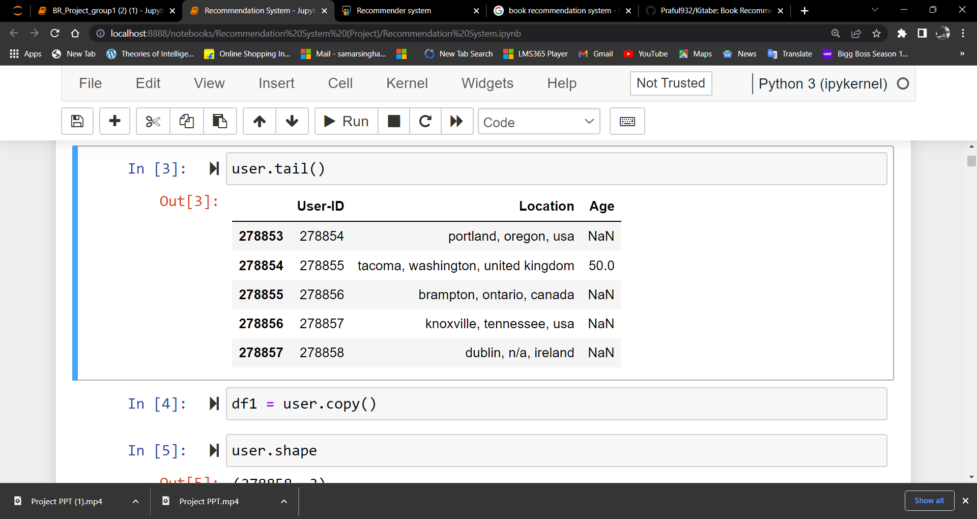
Overview of Dataset
It’s a dataset containing User ID, Location and Age.
There are 2,78,858 user-Ids. And 1,68,096 age values.
The mean value of age in the dataset is 34
Minimum value of age is 0 and maximum value is 244 which is unusual.
There are no duplicate values in this dataset
But There is one null in the User ID column and 110762 null values in the age column which contains 39.72% of the dataset
Head (5) :
Data description
Tail (5) :

Slide 6
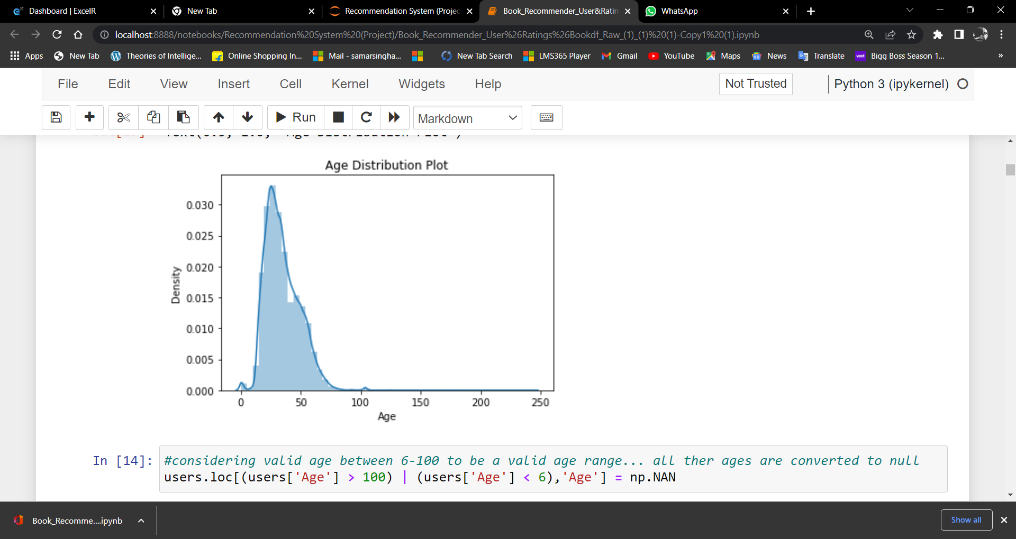
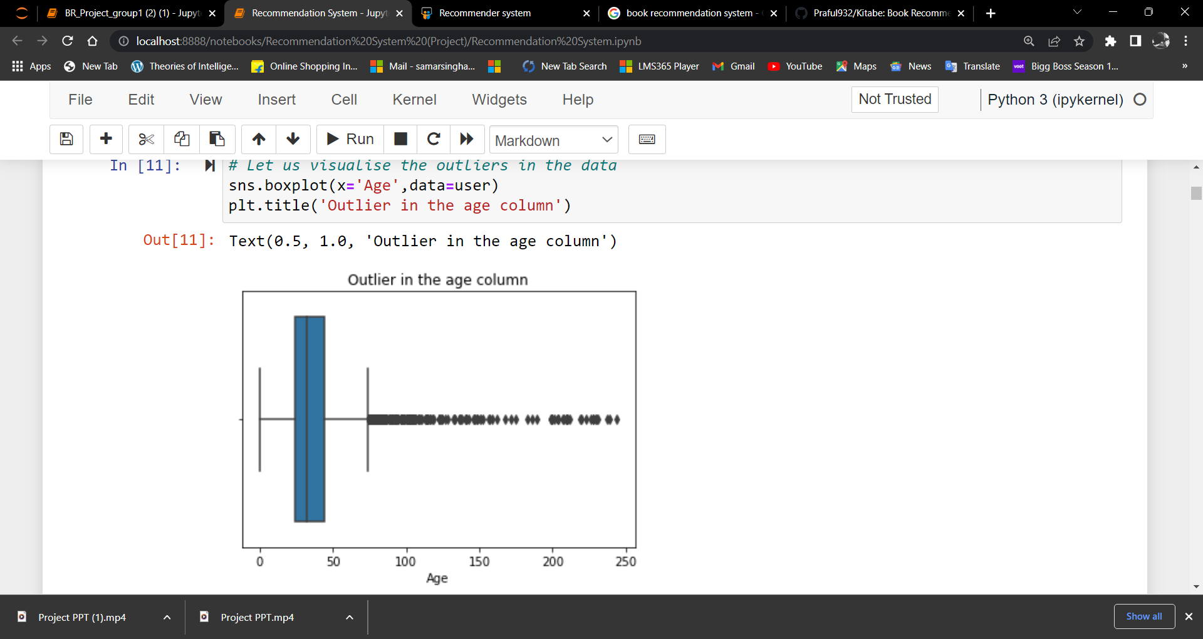
As the distribution is right skewed and as we have seen in the box plot, there are more outliers on the right side.
From the info, we get to know that, there are many null entries in the Age column . As the 39.72% of the data is missing(Before treating outliers), We have to impute the missing values of Age without dropping them.

Slide 7
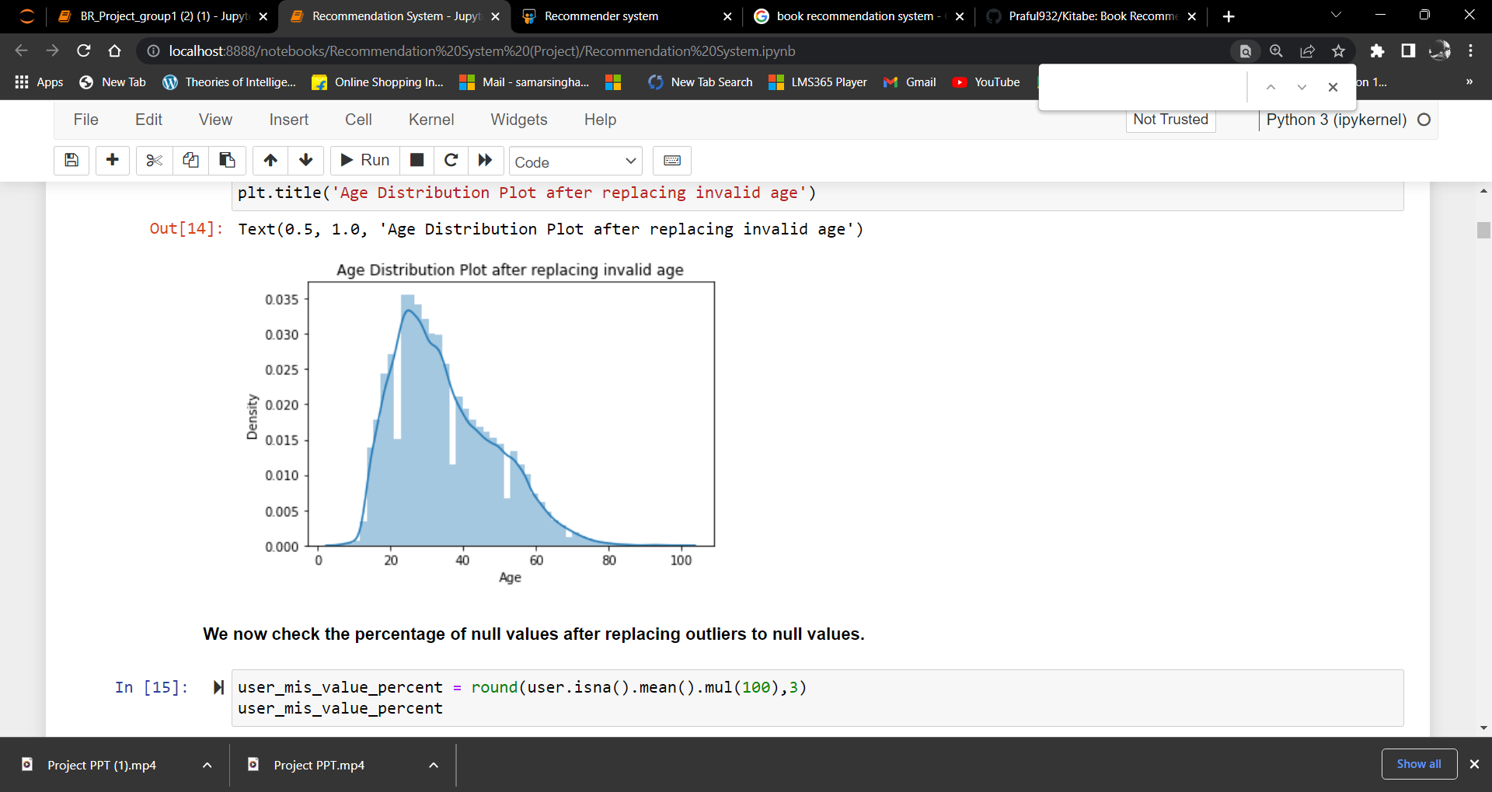
OUTLIERS IN THE DATASET:-
There are some age values which are below 6 and above 244. We have converted them to null values. After replacing outliers to null values, we have 40.177 null values.

Slide 8
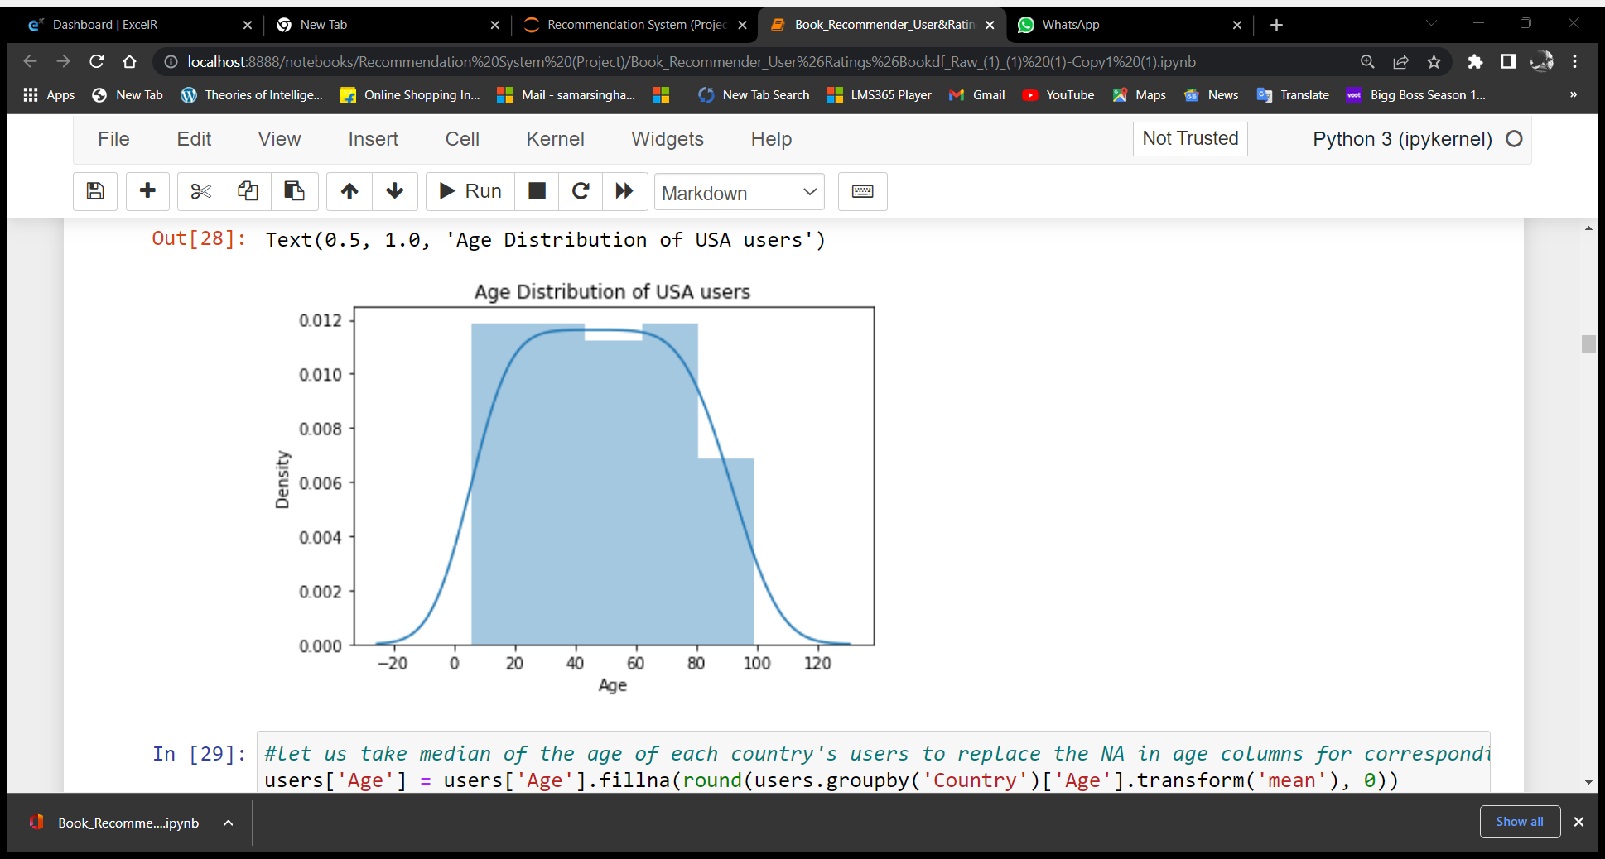
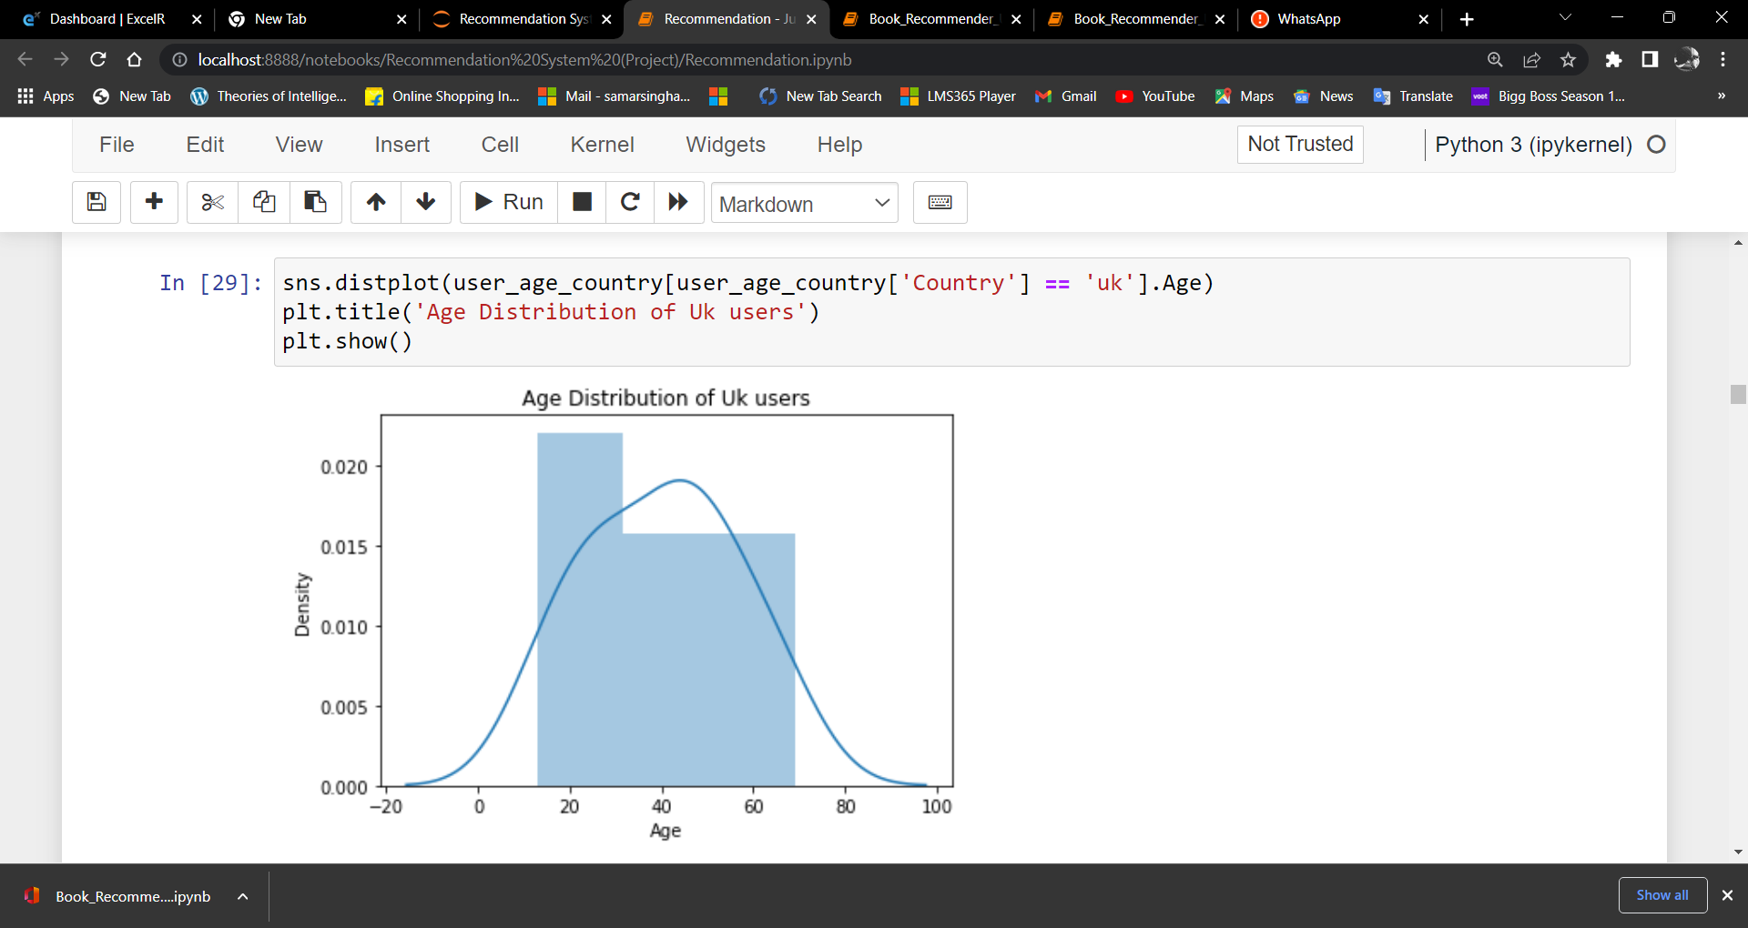
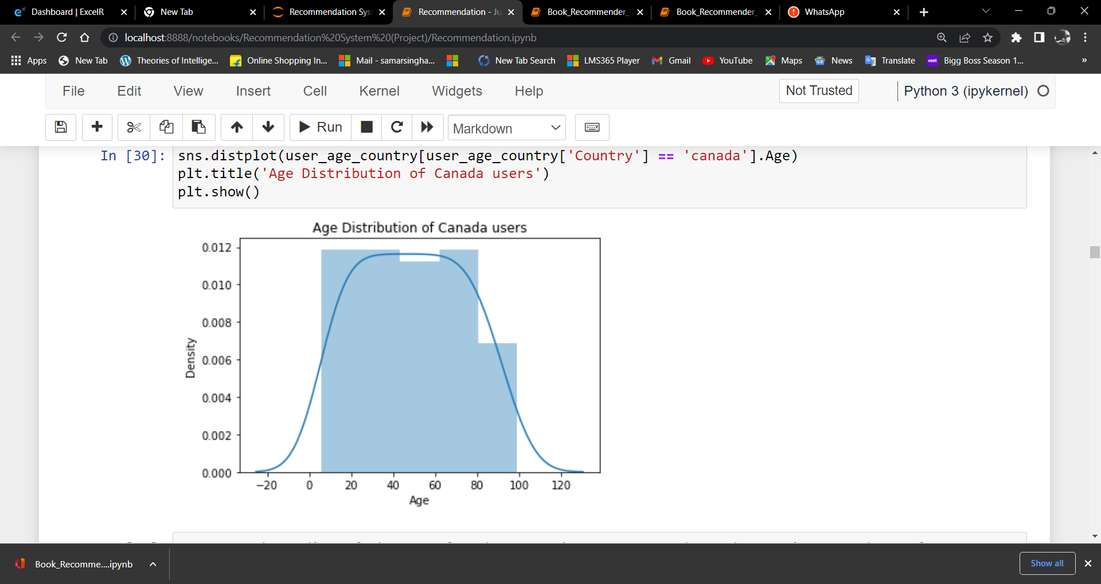
MISSING VALUES IN THE DATASET:-
After splitting the locations country, state and city and removing all the special characters and spaces from the country name, we have grouped the age by country name. Then we have replaced the null values by the median of the respective countries.

Slide 9
=>For USA, the age distribution is same for all the Ages. That means, the readers of USA are of the Age between 6 – 100
=> In UK, the readers Age are from 15 - 25 and more. And the Age range is between 15-70.
In canada, there are readers from 6 - 100 Age group. And the readers age group are from 6-80 and more.
we can impute the null values using median of the particular country as the data is right skewed

Slide 10
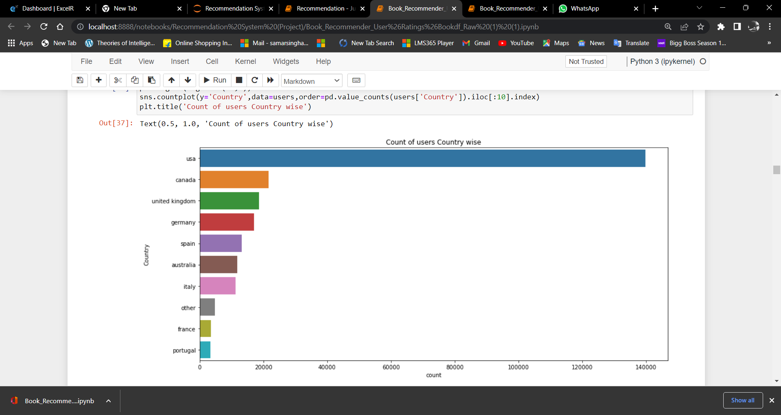
Users Country Wise
USA has highest number of users. So these may affect popular of the books in the whole collection

Slide 11
Books

Slide 12
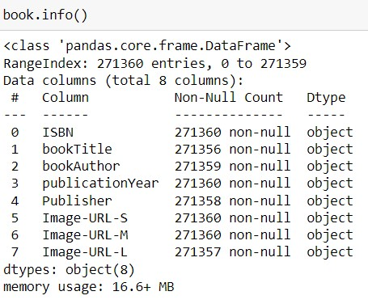
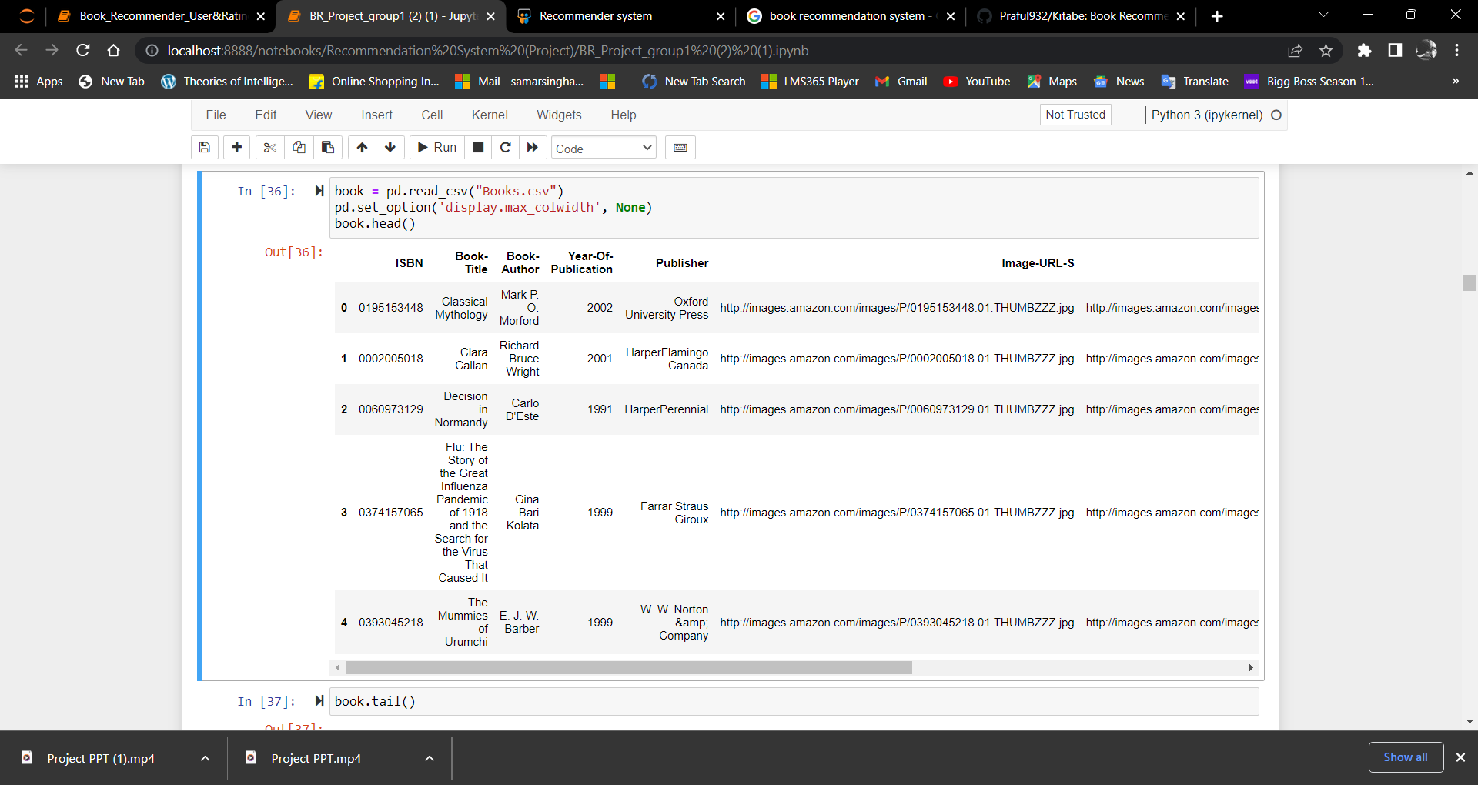
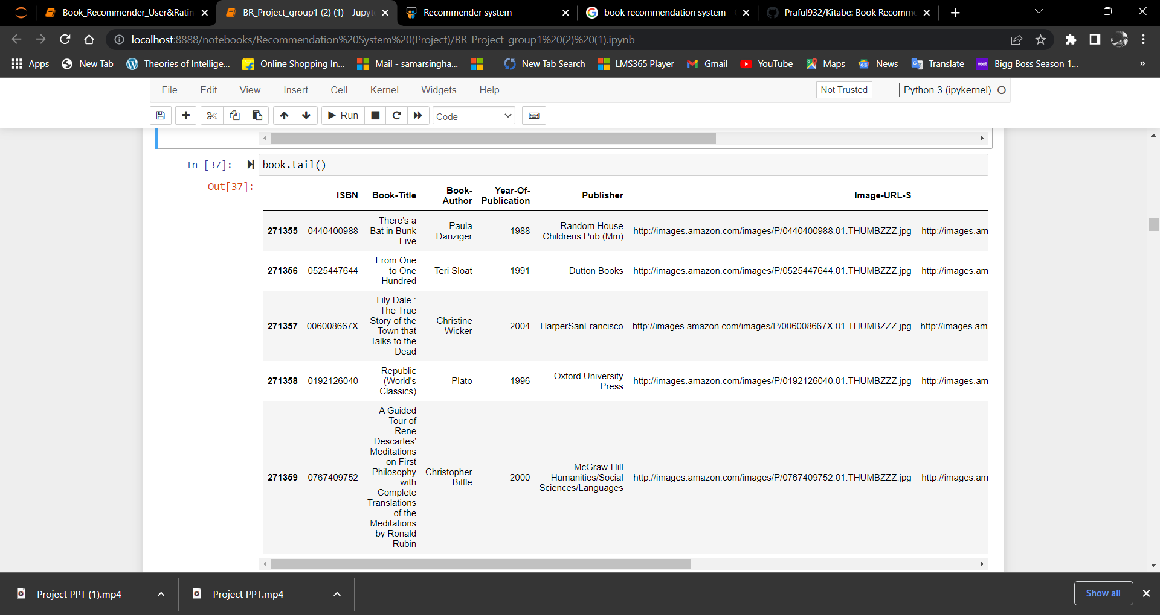
BOOK DATASET
Here there are 271360 unique ISBN numbers.
4 book titles are missing. Means, 271356 books are there in which 241360 book titles are unique
The Year of publication column should be integer type. It is showing as object. We have to treat that.
In some of the columns, columns from book-author have been shifted left, (title and author are clubbed in one row seperated by (\ " ;)
We have treated those columns

Slide 13
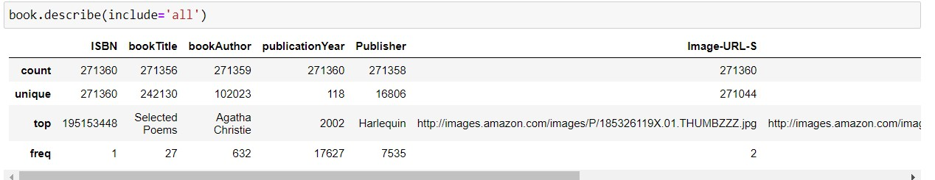
Here they are showing Agatha christie is a top author. It means her books are more. Here 632 books are written by Agatha Christie. One book author name is missing. Out of 271359 books, 102023 authors are unique.
There is no null values in year of publication. Books published in 2002 are more.
There are 2 null values in Publisher's name. 16806 unique publishers are there. Herlequin published the maximum number of (7535) books.
No null values in image URL S and M columns. There are 3 null values in image URL L column. And image URL also seems to have duplicates. We have to work on that.

Slide 14
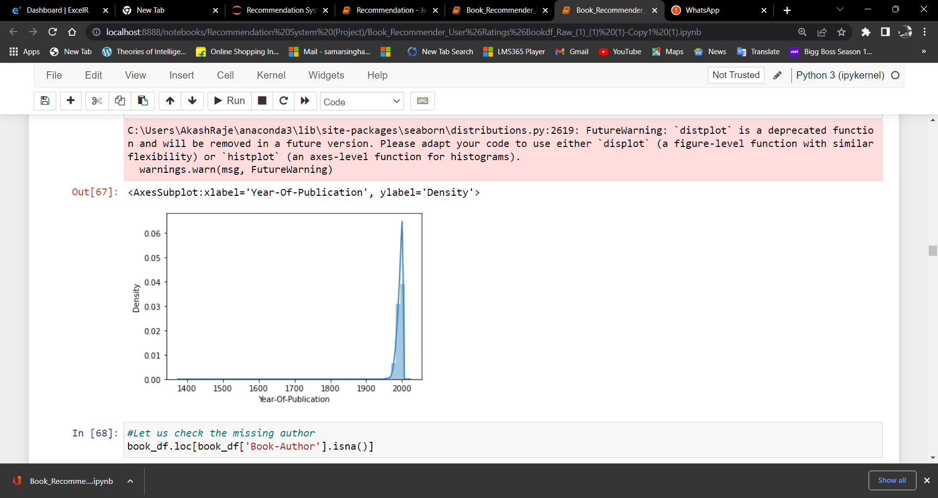
Year-of-Publication
=> There seems to be an error in Year-of-Publication as it is showing as object dtype and with no missing values.
=>The Year of publication column should be integer type.
We have treated Year-of-Publication = 0 and >2022 by replaceing it with null value and then replacing it with median of the dataset

Slide 15
DATA VISUALISATION

Slide 16
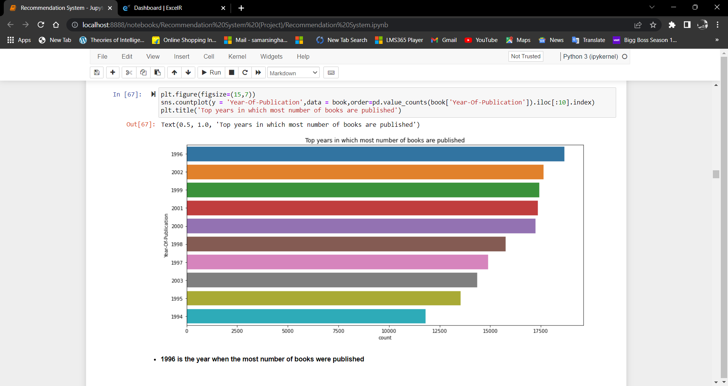
Top years with the most published books

Slide 17
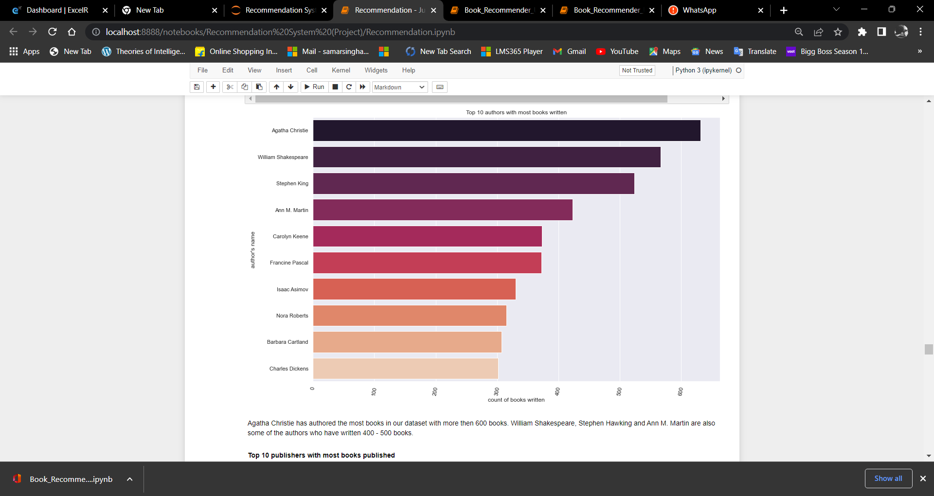
Top 10 Authors with most books written

Slide 18
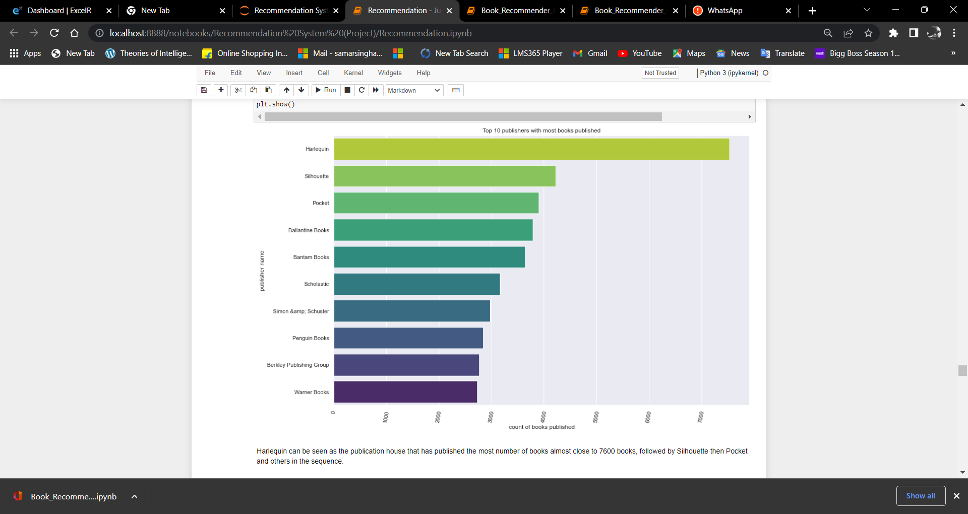
Top 10 publishers with most books published

Slide 19
Ratings

Slide 20
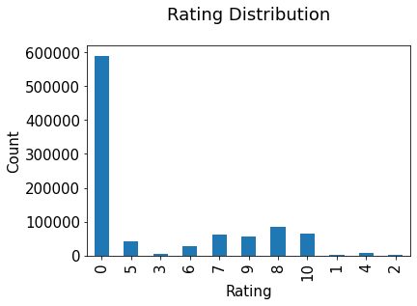
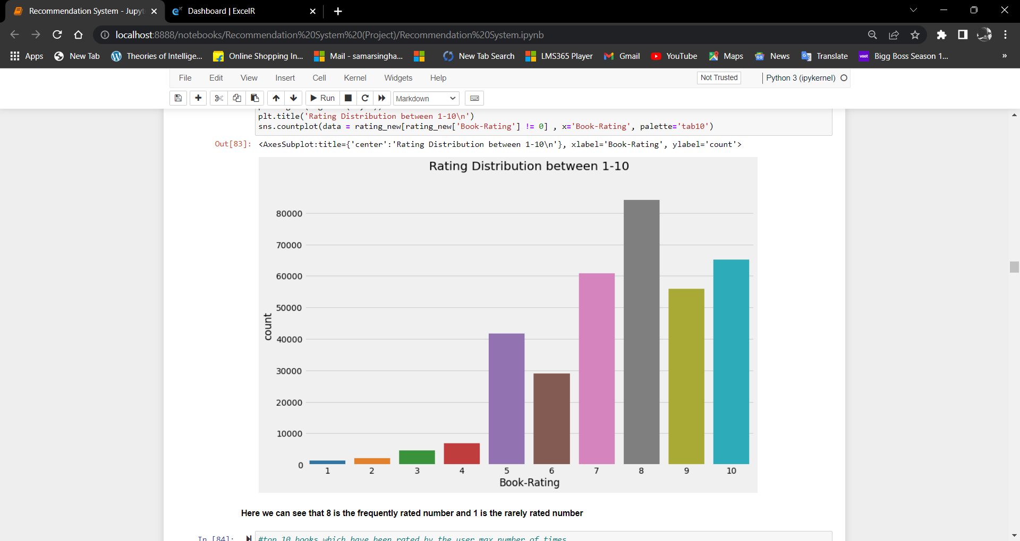
From the graph, We got to know that, the books are having 0 rating more than others. So, We checked the percentage of 0 rating books and the books which are rated 1-10. We got to know that the % of books that have been rated are 38% and those are not rated are 62.61% When we checked rating distribution between 1-10, we got to know that most of the users rated 8 for most of the books

Slide 21
Treating null values and duplicate values
There are no null values in the dataset. But there are 24 duplicate rows. And the percentage of duplicate values is 0.0022%. So We have removed those columns
ISBN which are not in book dataset but in rating dataset are removed. And they are 107454 rows. (They are about 10% of the dataset).
We will not be considering user that are not in the user dataframe but are in the rating_dataframe in the dataset as they will not help us to provide complete analysis.

Slide 22
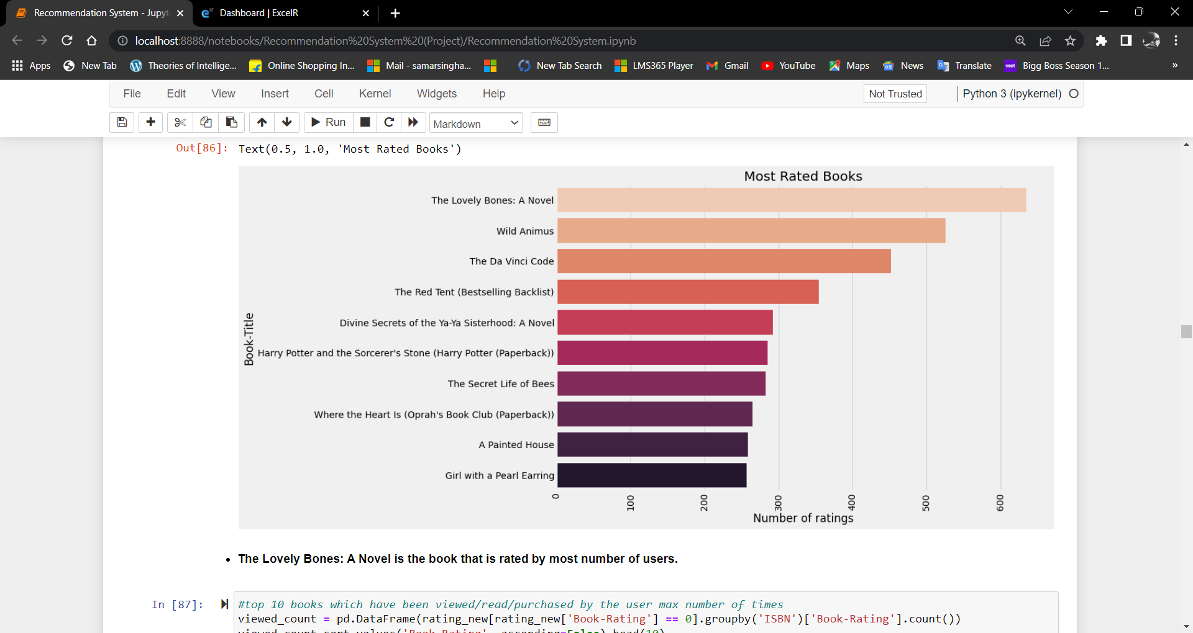
Most rated Books

Slide 23
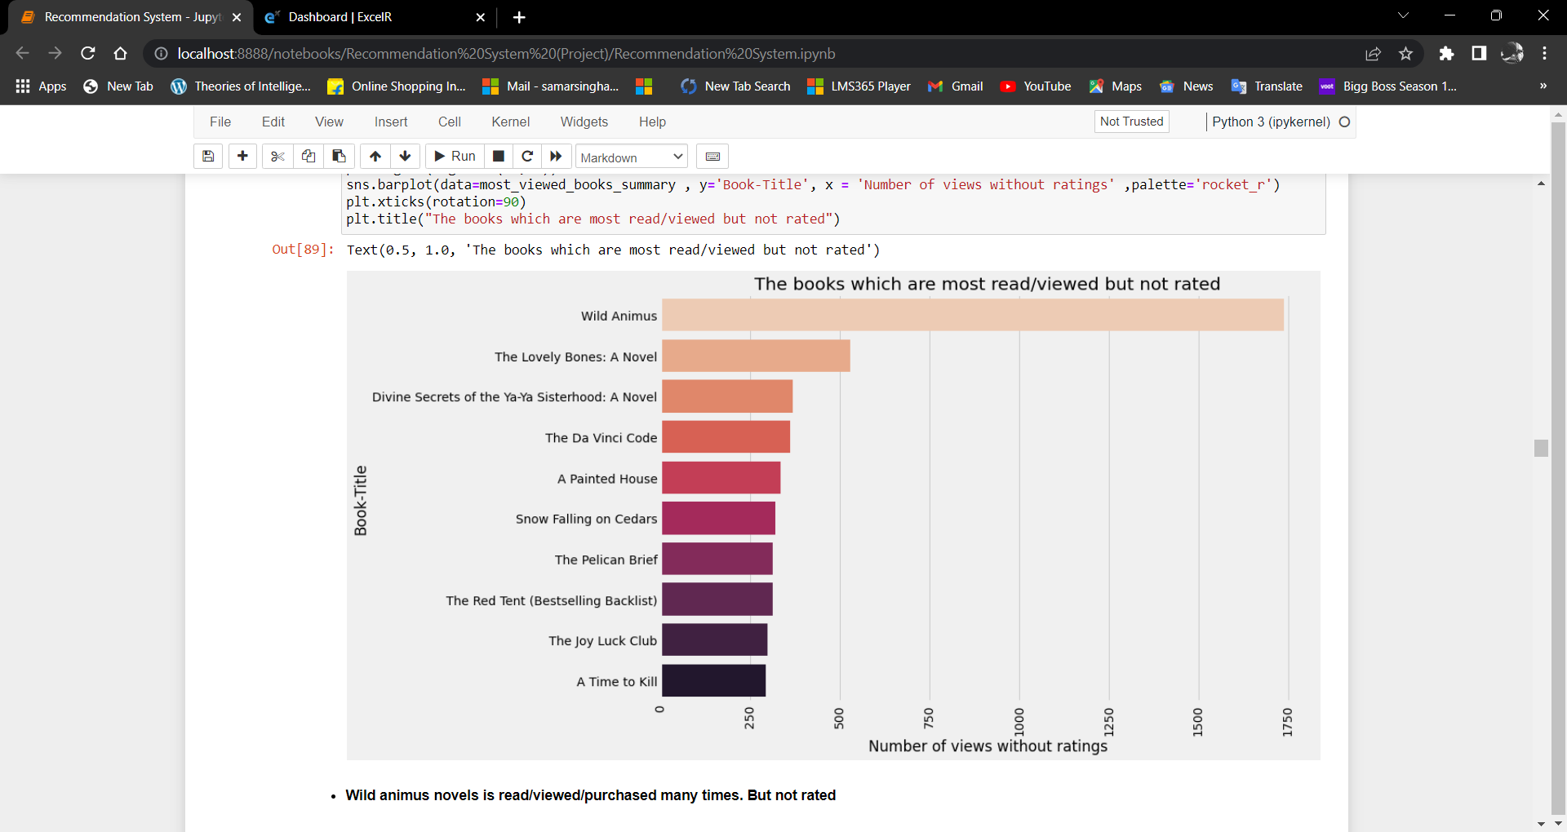
The books which are most read/viewed but not rated

Slide 24
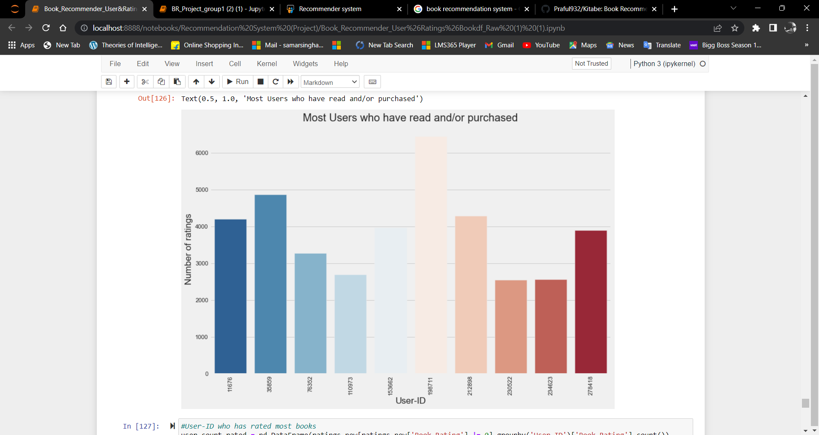
Most Users who have read and/or Purchased

Slide 25
Popularity based recommendation engine

Slide 26
Does Popularity differs for different countries?

Slide 27
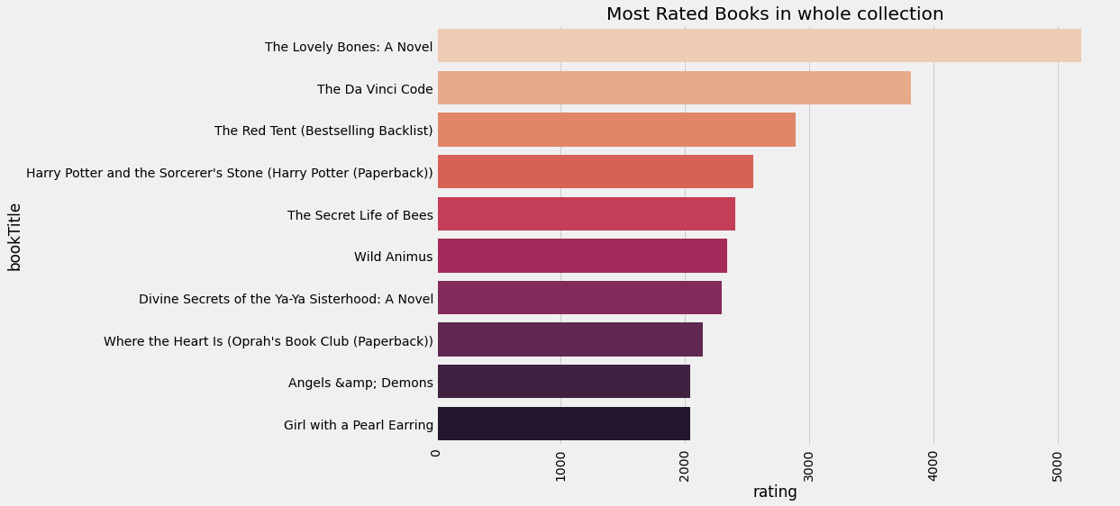
Popular book in whole collection
The above chart shows the top 10 books in whole collection. We can recommend these books to the people who don't provide information about their age or country
"The Lovely Bones : A Novel" is the most popular book even though it is read by less number of people(around 500) as compared to "Wild Animus" which is read by around 1750 people. But "Wild Animus" is the 6th Popular book.

Slide 28
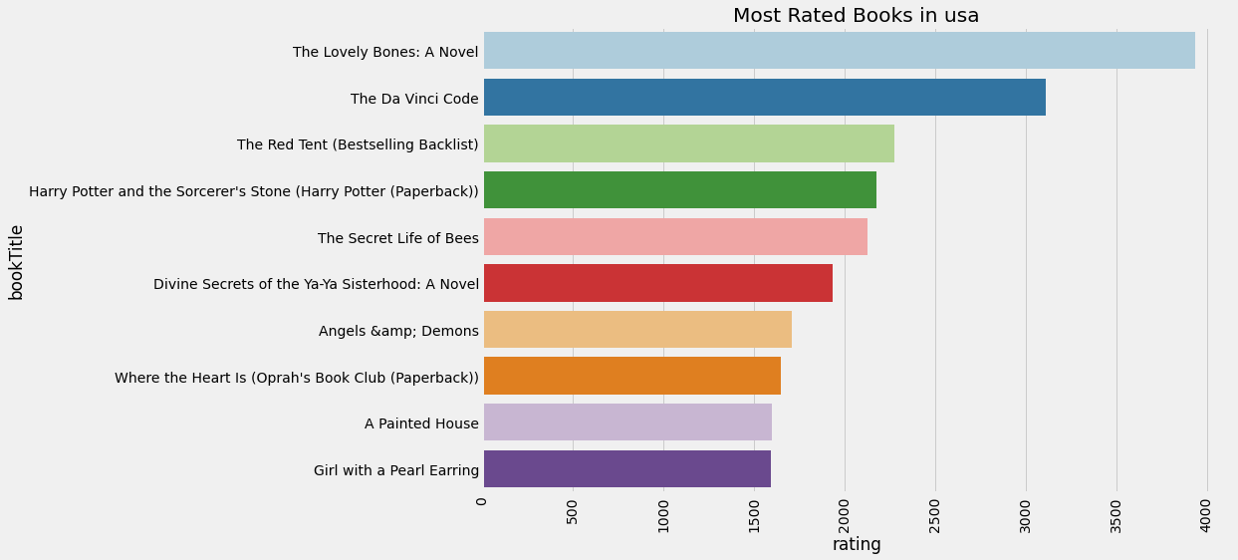
Popular books in USA
The above graph shows top 10 popular books in USA.
We have to observe one more fact that 9 out of 10 popular books of USA are same as popular books of whole collection. Because, USA contains about 60% of users in the whole dataset.

Slide 29
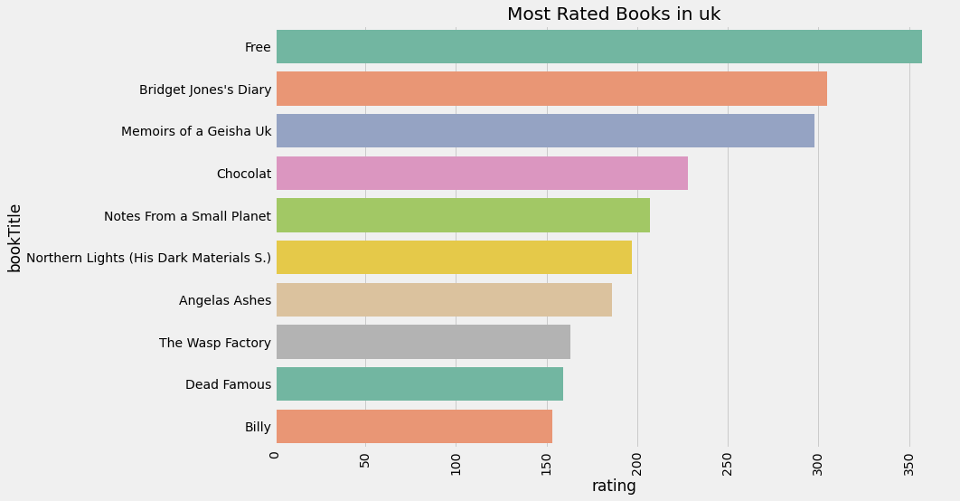
Popular book in United Kingdom
In UK, the most popular book is "Free".
We can see that Popular books of USA and UK differ from each other

Slide 30
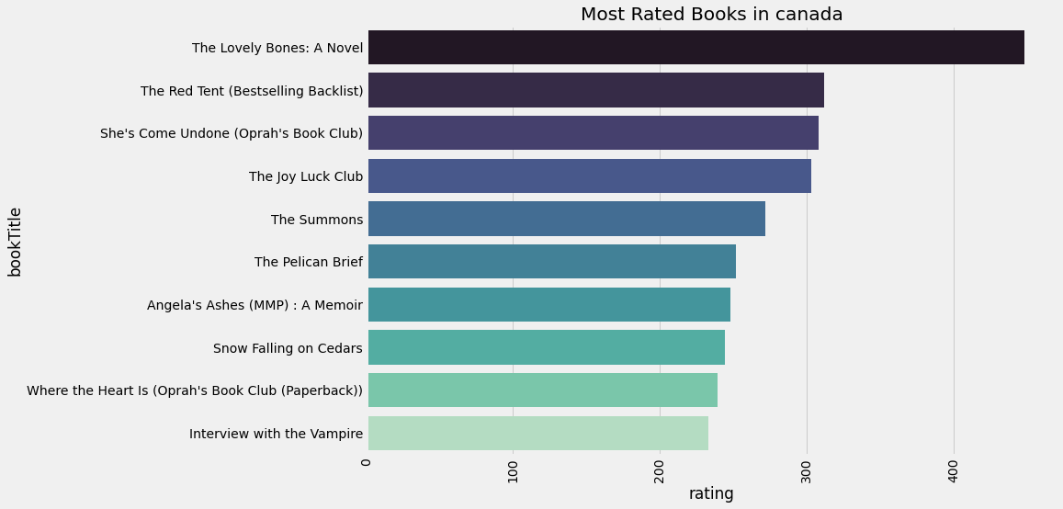
Popular books in Canada
Even in canada, Most popular book is The "The Lovely Bones : A Novel" is the most popular book.
The popular books of Canada, USA and UK are completely different even though USA and canada belong to the same continent
So, Popularity differ from country to country. So we have to build different recommendation engine to different countries

Slide 31
Does Popularity differs for different age groups?

Slide 32
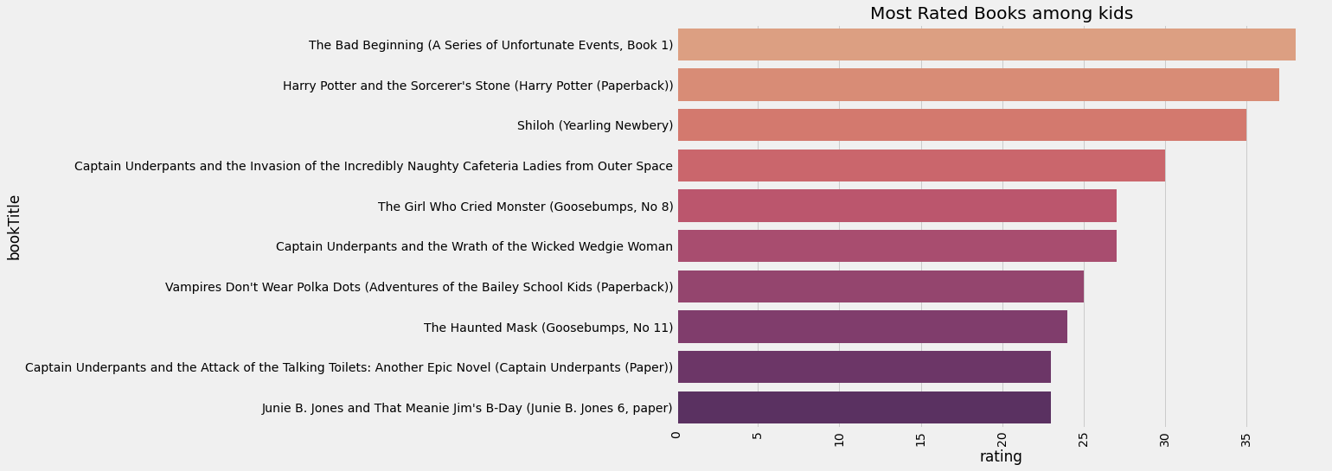
Popular books among kids
Harry Potter and Sorcerer's stone is the most popular book among kids

Slide 33
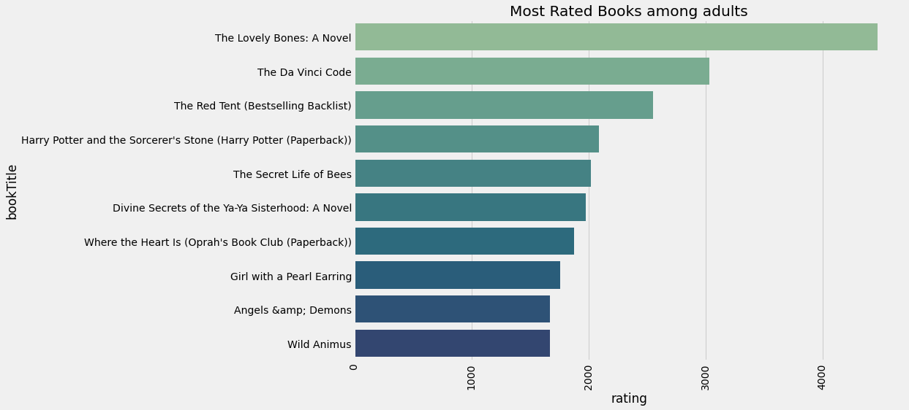
Popular books among adults
The Lovely Bones: A Novel is popular among adults
The 9 out of 10 popular books for adults is same as popular book for the whole collection. Because, Most number of users are adults in the whole dataset

Slide 34
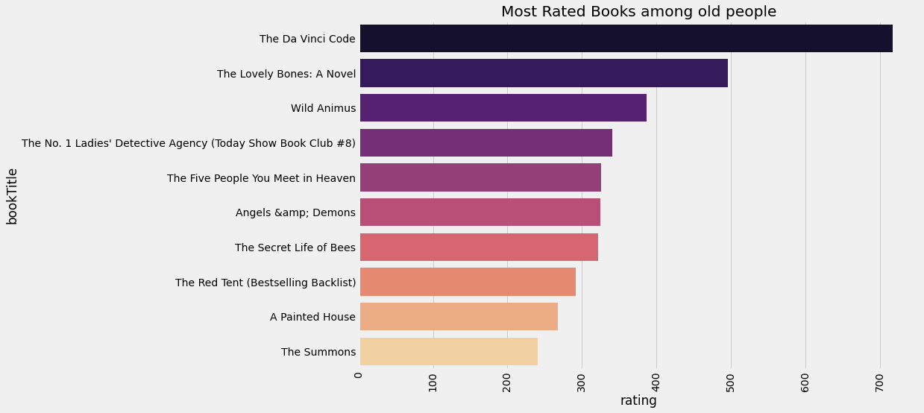
Popular books among old people
"The Da Vinci Code" is most popular book among old people.
6 out of 10 books are same for old people and the whole collection and 5 books match for adults and old people
As the Popular books differ according to age group. So we have to build different recommendation engines for different age groups

Slide 35
Most Popular books for different publication centuries

Slide 36
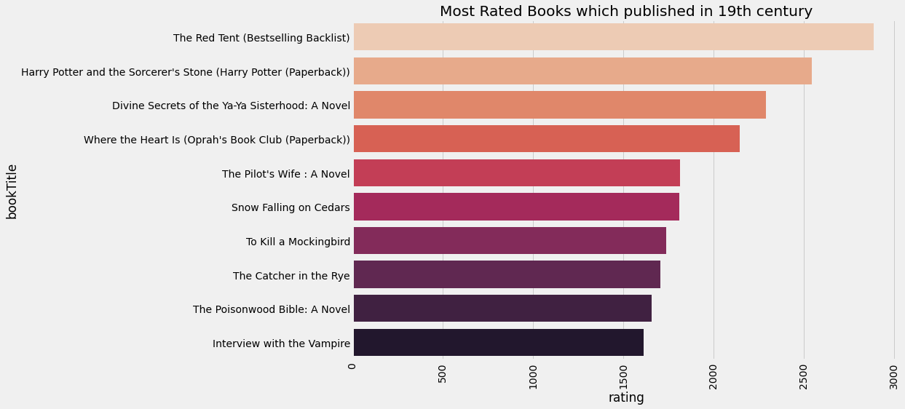
Popular books of 19th century
Among the books published in 19th century, "The Red Tent" is the most popular book

Slide 37
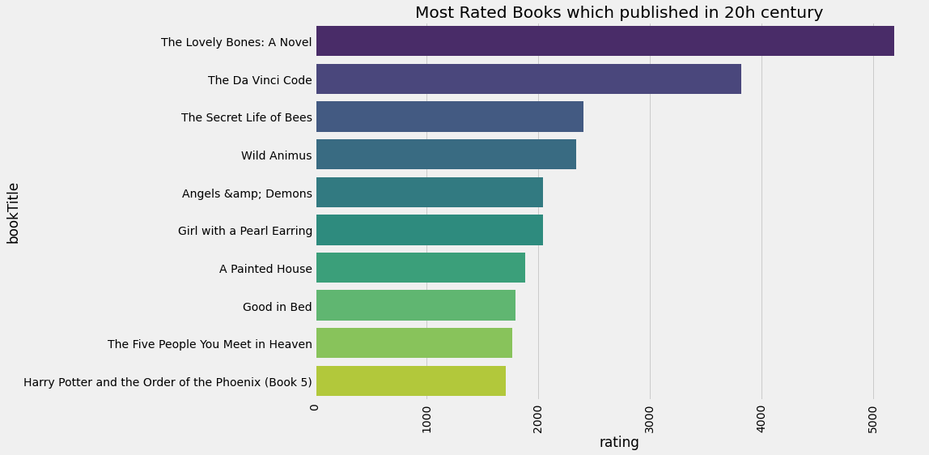
Popular books of 19th century
The Lovely Bones : A Novel is the most popular book among the books published in the 20th century.
The 6 books out of 10 books in the popular books of whole collection are published in 20th century

Slide 38
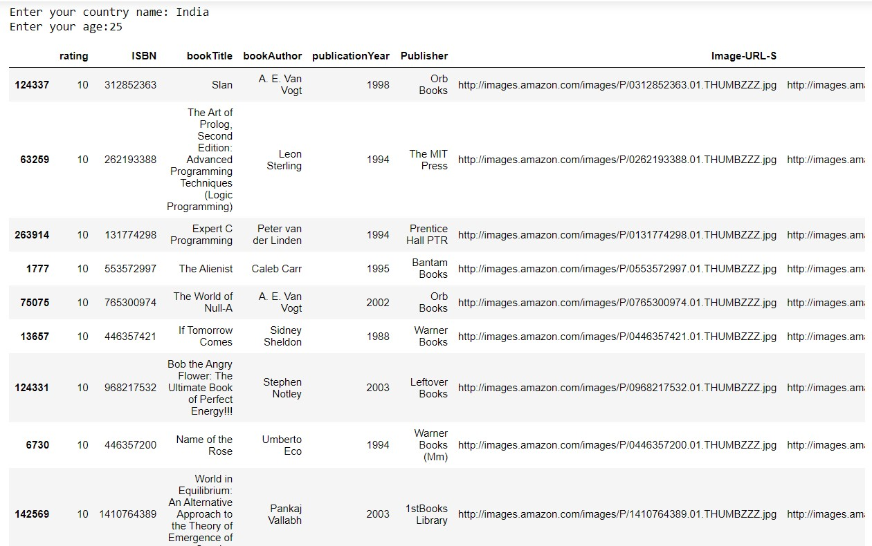
This is the list of popular book for a person living in India and is 25 years of age

Slide 39
Collaborative Filtering

Slide 40
In this technique, we predict the books that the given user might like on the basis of the ratings given by the other users who have similar taste with that of the target user.
We have checked that in our data frame, the number of users were less. So we have used user based collaborative filtering technique.
First we have filtered the users who have have rated more than 200 times and more than 50 for making data frame smaller and faster.
We first compared each user Ids according to their book ratings using pivot table and by using cosine similarity.
Then we have got the list of similarity value of each user with the given user and then we have sorted it in the descending order.
Then we have located the list of similar users in our original data frame

Slide 41
In the data frame of similar users, some of the books which are read by the given user were also there.
So we removed the books read by the given user and then recommended the remaining books according to the ratings(in the descending order).
Addressing the cold start problem
As we have filtered the users who have rated more than 200 times and more than 50, the users who don’t fall under that range will not be having any recommendation
To address this issue, we combine collaborative and popularity based engines and the users who are new to the app will get the popular books based on their country and age as the recommendation
Those users who don’t mention their country and age because of some reason will get the popular book in the whole collection as the recommendation

Slide 42
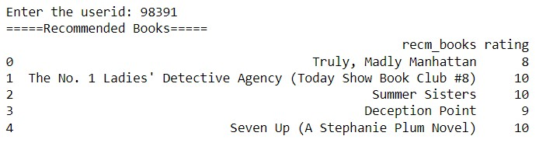
So here are the books recommended to user Id 98391 along with the rating

Slide 43
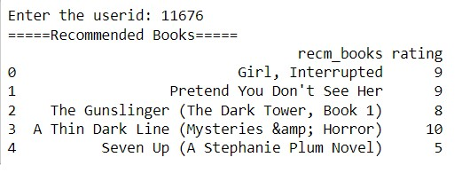
These are the books recommended to user Id 11676 along with their ratings

Slide 44
Evaluation of the user based collaborative model

Slide 45
Evaluation of our model
So for the evaluation, while recommending we consider the top rated books in the data frame having books read by similar users
But here we don’t remove the books which already read by the user Id.
If this evaluation engine gives us all the books read and books rated more than 5, then our model is good. Because if the books which are most liked by given user is recommended while doing evaluation, then after removing the books read by the user, the likelihood of user liking the books is more.
So we took the sample of 5 random users and we checked the number of books rated more than 5, less than 5 and books which are not read by the user in an excel sheet. Around 62% of the books we have recommended were rated >5 from given user. So we can tell out model is good.

Slide 46
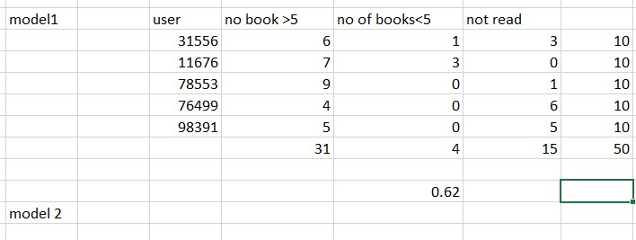
Table showing Evaluation

Slide 47
THANK YOU

